Slide 1

Welcome Back
2026-2027 School Year

Slide 2
Important Contacts
Shelby Keifer, Personnel Secretary skeifer@wcesc.org
(419) 354-9010 ext. 305
Tracy August, Payroll Specialist taugust@wcesc.org or payroll@wcesc.org
(419) 354-9010 ext. 213
Karen Keller, Payroll Specialist kkeller@wcesc.org or payroll@wcesc.org
(419) 354-9010 ext. 212
Julie Bulkowski, Executive Secretary jbulkowski@wcesc.org
(419) 354-9010 ext. 217

Slide 3
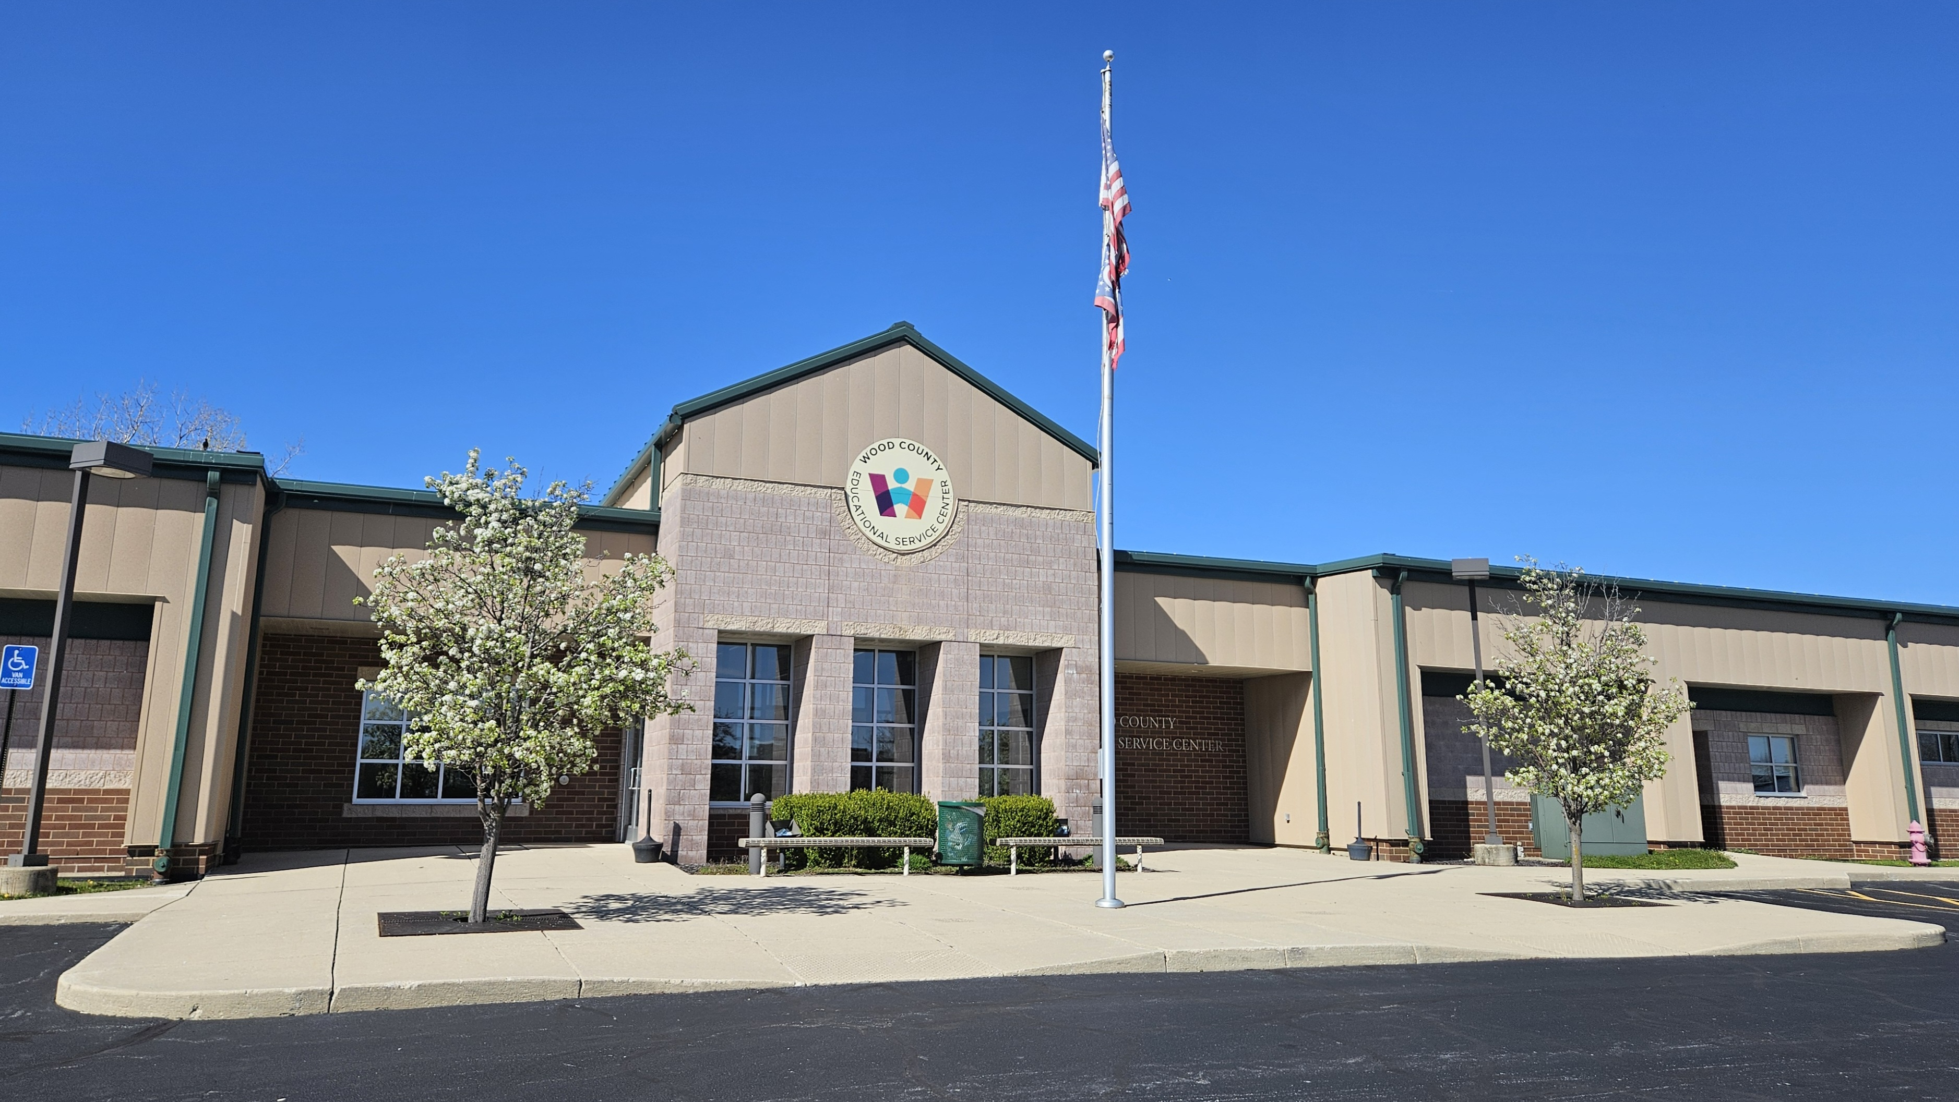
Important Pay Dates
New Employees
1st pay September 4th
1st check will be a paper check you elect to pick up or have mailed.
Everyone Else
1st pay September 18th
See Page 7 of Handbook for Pay Schedule

Slide 4
Stretch Pay Calculation if Applicable
Hours per Day
Contracted Work Days per Year
Total Contracted Salary
Rate of Pay
Total Contracted Salary
# of Pays Remaining in the Year
Bi-Weekly Pay Amount

Slide 5
Absences and Leave Balances
What are my leave balances?
Where can I find my leave balances and usages?
Sick leave is accrued the last day of each month
3 personal days each year
If you do not work 5 days a week, personal and sick leave may be prorated
At the bottom left corner of each pay stub
Your Red Rover Account

Slide 6
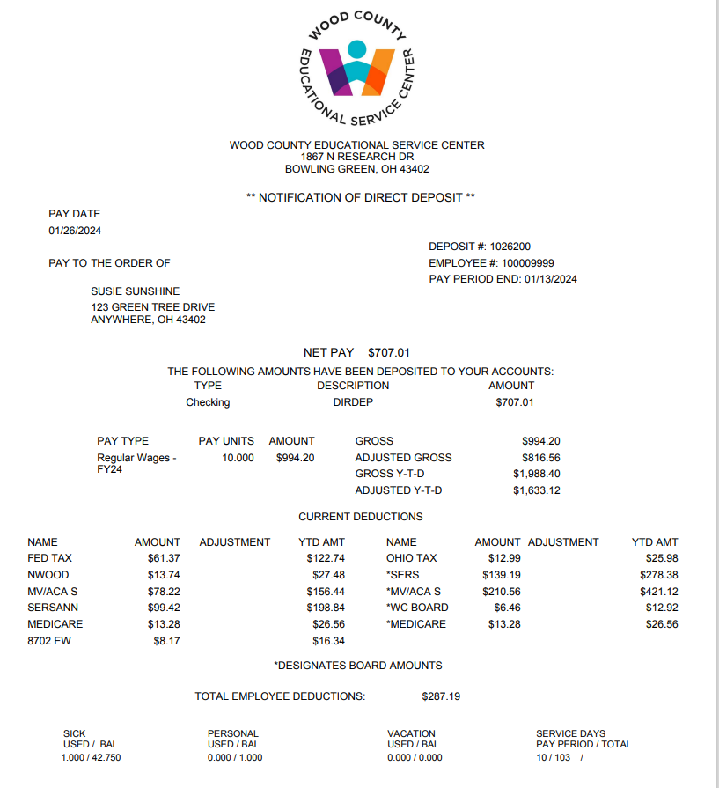
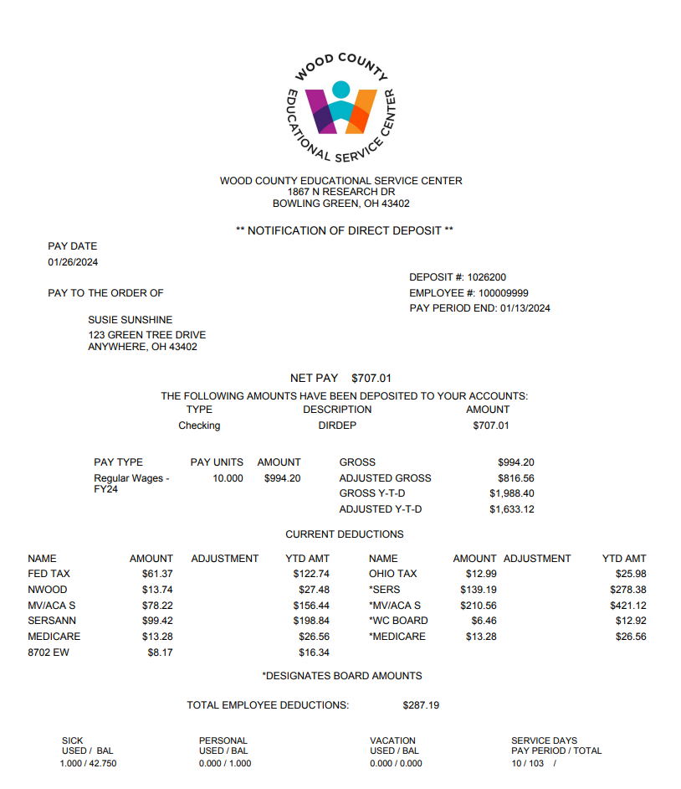
Sample Pay Stub
Deduction Abbreviations
SERSANN – Employee Contribution of SERS (School Employee Retirement System)
STRSANN – Employee Contribution of STRS (State Teacher Retirement System)
MV/ACA – MVP Health Insurance Premium
PPO:E-S or F – PPO Health Insurance Premium
DEN:SING or FAM – Dental Insurance Premium
8702 EW – Example of School District tax (usually 4 digit #)
# of Days in Pay Period
Leave Usage & Balance
Board Paid Deductions **identified with asterisks

Slide 7
Insurance Benefits
What am I eligible for?
30-34.99 hours per week – MVP eligible
Only 35+ hours per week are eligible for Dental Insurance
When is open enrollment?
In the spring – no later than May 30th for July 1 enrollment
Deductions begin in with the first check in June
If you have a qualifying event during the year you have 30 days to sign up or change your coverage
35+ hours per week – PPO or MVP eligible

Slide 8

Vision Insurance
  … Is available through American Fidelity via Eyemed and IS NOT included with your regular health insurance plan!
  Vision insurance isil abe throughAmerican Fidelity via Eyemed and IS NOT included with your regular health insurance plan!
For Information contact:
American Fidelity Representative
Office: 513-770-1678

Slide 9
Voluntary Insurances / Deductions
We offer Voluntary Insurances through American Fidelity
We offer the 403b and 457 Investment options
If you have questions about any of these, please let us know or reference the handbook on pages 15 and 16.

Slide 10

Employee Assistance
Wood County Health Benefits EMPLOYEE ASSISTANCE PROGRAM (EAP) is a no cost benefit provided to all employees and eligible dependents. This benefit provides confidential access to solution-focused counseling and motivational coaching support to help you manage life stressors and challenging issues.

Slide 11
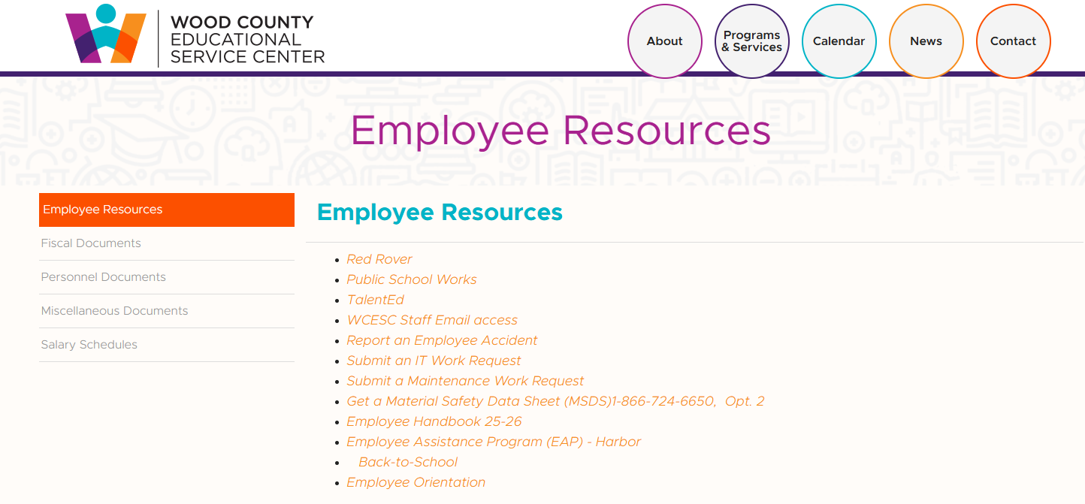
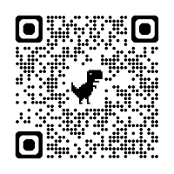
QR Code Link to Employee Resource Page

Slide 12


Slide 13
PERSONNEL REMINDERS
& Updates

Slide 14

What I do…
Talent Ed Password Changes
Red Rover Timesheets & Absences & Other Issues
Personnel Forms
Call-Off Management
Background Checks
Paraprofessional Licensing
Substitute Management
My contact information:
Office Phone Number: (419)354-9010, ext. 305
Email: skeifer@wcesc.org

Slide 15

Bereavement
Qualified sick leave
You may take up to 5 days of sick leave for bereavement
of an immediate family member.
(These days count in your sick time.)
The WCESC considers the following as immediate family members:
Spouse | Parents
Step –Parents | Siblings
Children | Step-Children
Grandparents | Father or Mother-in-law

Slide 16

Personal Days
Personal leave days may be used for personal obligations that are necessary & compelling, which involve family events, community events, business transactions, or legal transactions.
Payroll/Employee Procedures, abbr. pg 11

Slide 17
Restrictions to personal day use
The day(s) may not be used in conjunction with any holidays/vacation days.
They day(s) may not be used in the first ten(10) or the last ten(10) working days of the school districts’ calendars.
Requests for personal days must be entered in Red Rover at least three(3) school days in advance and be approved by your supervisor.
Payroll/Employee Procedures, abbr. pg 11-12

Slide 18



Slide 19
Accurate ATTENDANCE records are essential
All staff must log their absences through the Red Rover Management on-line system. It is the employee’s responsibility to verify the accuracy of the absence requests. (i.e. sick time, personal days, etc.)
Payroll Employee Procedures, abbr. pg 10

Slide 20
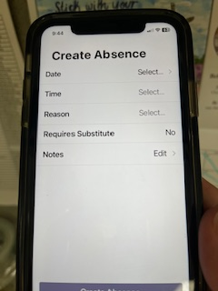
Reporting absences as early as possible is key!!
Early reporting of absences gives us ample time
to try and find a substitute.
Things to know:
Red Rover will NOT accept absences created after 6:30am for the same day. (This includes leaving early for the day.)
After 6:30am, text me at (419)308-4147 and I will respond letting you know that I’ve entered your absence for you.
PLEASE, PLEASE, PLEASE ~ DO NOT email or call the WCESC office to call-off on the same day.

Slide 21
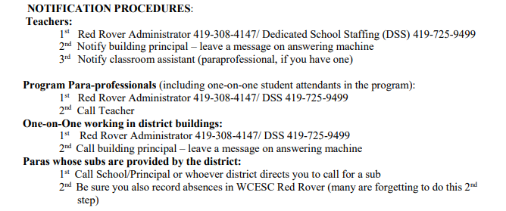
Taken from Page 12 &13 of the Handbook

Slide 22
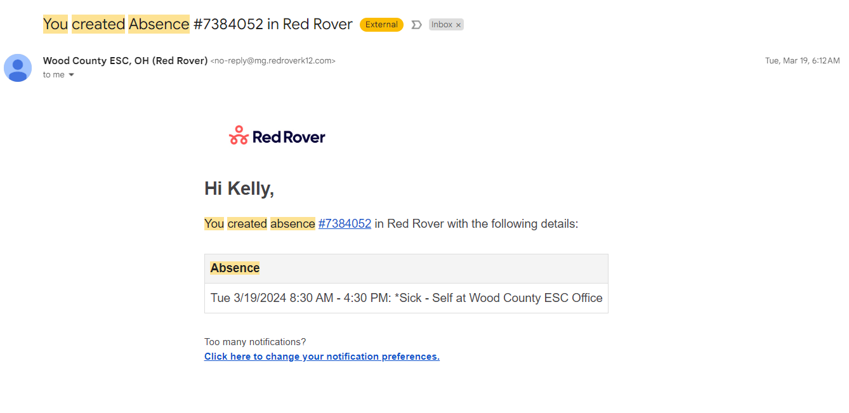
This is what an emailed absence confirmation looks like

Slide 23


